Slide 1


THE SECONDARY SCHOOL
LEŞILE – DOLJ
COMENIUS MULTILATERAL PROJECT
“DEMOCRATIC VALUES
AND
LINGUISTIC DIVERSITY”
13-PM-210-DJ-ES

Slide 2
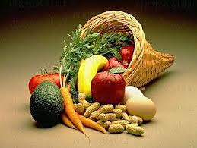
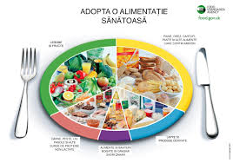
MOBILITY IN TURKEY KOCAELI
13-16 OCTOBER 2014
FOOD
AND
NUTRITION

Slide 3


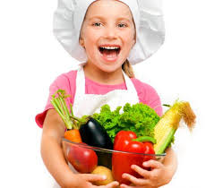
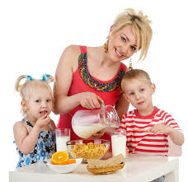
THE NUTRITION OF THE HEALTHY MAN
"When the stomach speaks, it thinks about food”.
Nutrition
-is the habit that is affecting most people’s
health.
-it is a voluntary and conscious process and
this is why it is teachable.
-it depends on a free decision of the individual.
-the adherence to healthier eating habits requires a deep conviction.
-90% of all diseases, with the exception of accidents and infections, are closely related to food.

Slide 4
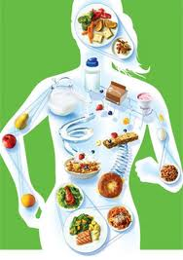
NUTRITION
- it is involuntary and unconscious.
- it includes all the processes and the
transformations which food undergoes in the
body until their complete assimilation.
- a good diet should have a good nutrition.
- no food, taken separately, may not provide all the nutrients that our body needs.
-our diet should include a variety of rational food.

Slide 5

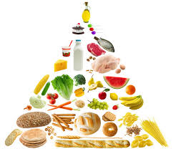
The healthy food pyramid
- shows in what proportion should be on our table, different kinds of food:
1- food group 1
-you can eat them in abundance
- should be the basis of
Our food diet: fruit,
grains and vegetables;

Slide 6
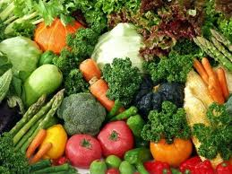
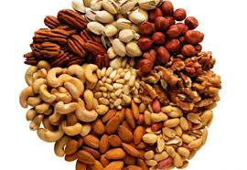
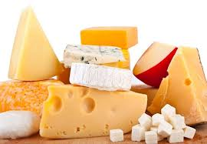
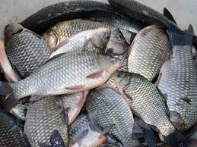
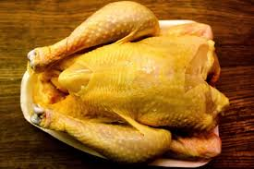
2- food group 2
- you must eat them with moderation
are those which contain a significant proportion of protein, like:
vegetables,
dried fruits,
milk and its derivatives,
fish
chicken.

Slide 7
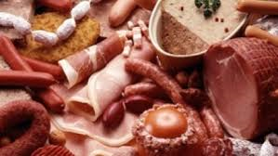
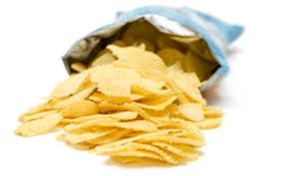
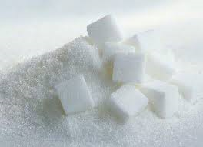
3- food group 3
you must eat in small amounts:
- animal fats-butter, fatty cheeses, ham and cold meats are some of the most harmful foods of the
western diet.
- they increase the level of cholesterol and contribute to atherosclerosis, which can cause death.
- nother food that should be avoided until disposal is sugar
-it provides "empty calories".

Slide 8
-everyone's health and balance, is in direct correlation with the food.
-the habit of eating right, appropriate, brings a healthy life
-it is not important only what do we eat, but also how, when and how we eat.
-a diversified diet, correctly composed in terms of caloric values and complying with the optimum ratio of proteins,lipids,carbohydrates
and vegetable fibres, can be regarded as a balanced diet.

Slide 9
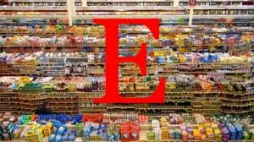
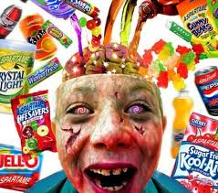
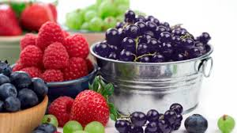
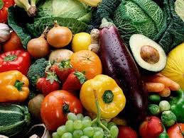
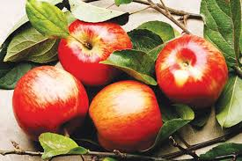
-not every food is beneficial to the human body.
-the quality of a food appears both from its coming source and from its processing mode, industrial or domestic

Slide 10
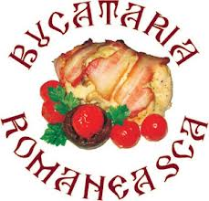
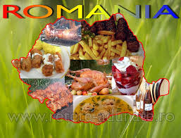
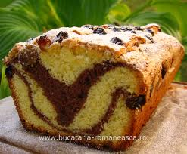
Romanian kitchen
- it is diverse,
- includes many customs and culinary traditions,
- romanian specific dishes but also appeared from the intersection with other nations.
- romanian cuisine includes both everyday meals and special holiday dishes.
- romanian dishes are made from vegetables, grains, vegetable oils, milk, milk products, meat and meat by-products.
-a special place in the Romanian cuisine is
occupied by sweets, pies and jams.

Slide 11

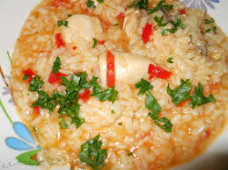
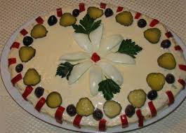
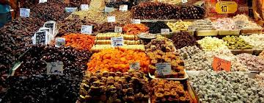
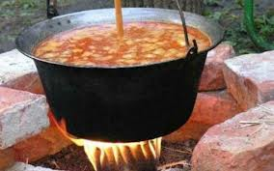
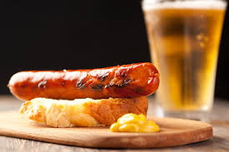
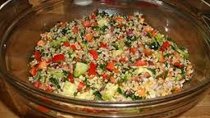
Influences in the Romanian cuisine
Through the intersection of cultures, Romanian cuisine has been influenced by:
balkan kitchen
turkish kitchen
hungarian kitchen
german kitchen
oriental kitchen

Slide 12
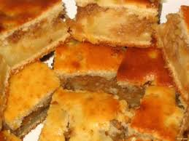
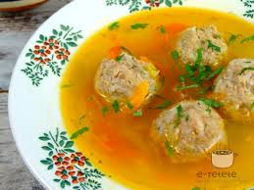
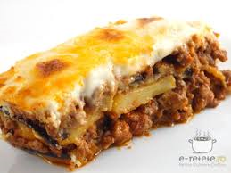
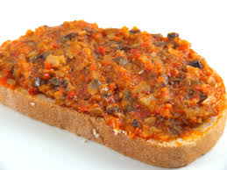
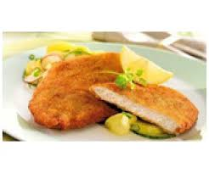
-the gastronomic culture of the Romanian people had inherited numerous culinary habits:
-the pie comes from the Romans
-the Turks have brought the soup with minced meat balls
-the Greeks had brought the moussaka,
-the Bulgarian brought us a wide variety of dishes
based on vegetables, such as vegetable stew
-the Austrians brought us the schnitzel.

Slide 13
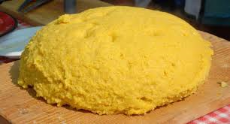
Typical Romanian dishes
-one of the typical Romanian dishes is MĂMĂLIGA.
-this is a food made from
corn flour boiled in water with salt.
-it was used frequently in the diet of peasant, farmers and breeders.
-in the Romanian cuisine is very often consumed pork, but also beef, chicken, lamb or mutton and venison.
.

Slide 14
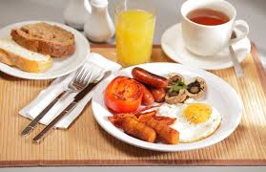
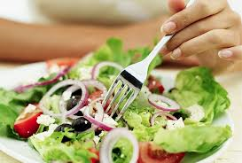
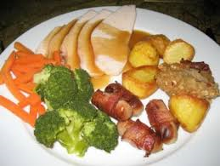
Main meals of the day
-breakfast
- lunch
- dinner

Slide 15
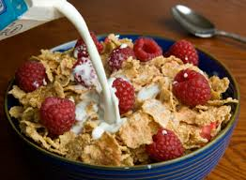
BREAKFAST
Breakfast can be made of:
milk, cheese, yogurt, fresh or fermented cheese, cereals and bread.
meat products: salami, ham, Bacon:
eggs in different forms: omelet, boiled or in various combinations with vegetables and meat
fresh fruits or prepared in the form of jams or marmelades

Slide 16
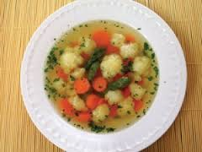
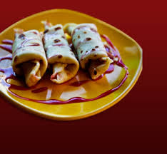
LUNCH
-a regular lunch is made of
3 types of food:
1-soup with meat and vegetables or only with vegetables
2-main course dish consists of vegetables, or meat and vegetable prepared in different ways, grilled dishes, steaks, etc..;
3-the dessert consists of cakes, pies, fruits, or pastry and fruit dishes.

Slide 17
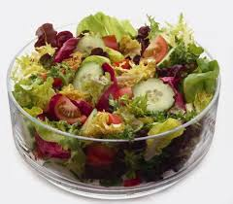
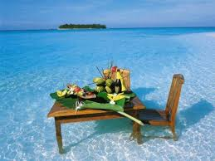
DINNER
-dinner has the same composition as the lunch,but generally excludes foods hard digestible for stomach.
-for children in their period of growth and the elderly persons the meal content of every day is supplemented with a snack at 10 o'clock in the morning, and a bite to eat at 5 p.m.

Slide 18
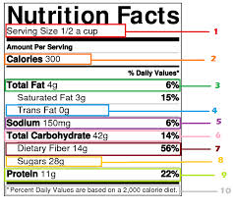
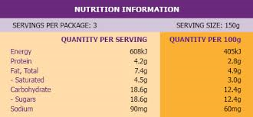
Nutritional computer
-is the ideal tool to understand, monitor and log the both what we eat and our physical activities. -it is an aid to both connoisseurs and for those who are still at the beginning of the road to a healthy lifestyle, fair and balanced

Slide 19

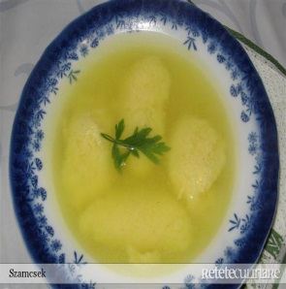
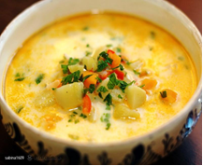
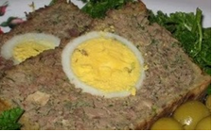
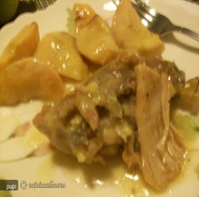
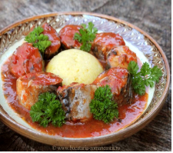
TYPICAL ROMANIAN DISHES
-soup with dumplings
-zucchini Soup
quince with Meat
-kell
-mackerel in tomato sauce
Romanian traditional recipes are in the Comenius cookbook

Slide 20

Thank you for your attention!
COMENIUS TEAM
OF THE
SECONDARY SCHOOL LEȘILE- DOLJ
Coordinator:Nadia Manda
Manager:Adriana Gherghe

